Slide 1
Proofs: Predicate Logic
CS 236
Fall 2021

Slide 2
Overview
Topics
Proof by Resolution in Predicate Logic
Assuming you won’t have read before class this week
Due
Project 2 is due Thursday, Oct 6
HW 9 and 10 due Monday, Oct 10
Midterm opens Thursday, Oct 13 and runs through Monday, Oct 17

Slide 3
Overview
Topics
Proof by Resolution in Predicate Logic
Please read before class on Wednesday
Due
HWs 6-7 due today
HWs 9-10 due Wednesday
Midterm October 19-21 (online, not proctorio’d)
Project 3 due Oct 28 – can begin Oct 8

Slide 4
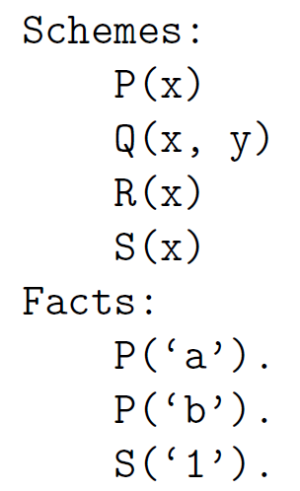
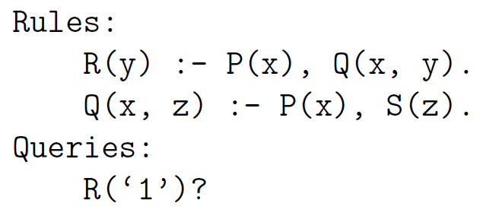
Overview
Topics
Proof by Resolution in Predicate Logic
Solve this problem

Slide 5
Overview
Topics
Proof by Resolution in Predicate Logic
Solve this problem

Slide 6
Overview
Topics
Proof by Resolution in Predicate Logic
Solve this problem
Notes:
\begin{array}{ll|l}
& \mbox{\textbf{Fact}} & \mbox{\textbf{Reason}} \\\hline
1. & P('a') & \mbox{premise} \\
2. & P('b') & \mbox{premise} \\
3. & S('1') & \mbox{premise} \\
4. & \forall x\forall y \Big[ P(x) \wedge Q(x,y) \rightarrow R(y) & \mbox{premise} \\
5. & \forall x\forall z \Big[ P(x) \wedge S(z) \rightarrow Q(x,z) & \mbox{premise}
\end{array}

Slide 7
Overview
Topics
Proof by Resolution in Predicate Logic
Solve this problem

Slide 8
Overview
Topics
Proof by Resolution in Predicate Logic
Prove R(‘1’)

Slide 9
Overview
Topics
Proof by Resolution in Predicate Logic
Prove R(‘1’)
We need a tool to relate quantified variables

Slide 10
Overview
Topics
Proof by Resolution in Predicate Logic
Prove R(‘1’)
We need a tool to relate quantified variables
to specific instances

Slide 11
Overview
Topics
Proof by Resolution in Predicate Logic
Prove R(‘1’)
We need a tool to relate quantified variables
to specific instances
We need a rule of inference that
always works

Slide 12
Overview
Topics
Proof by Resolution in Predicate Logic
Prove R(‘1’)
Universal instantiation
We need a tool to relate quantified variables
to specific instances
Resolution
We need a rule of inference that
always works

Slide 13
Predicate Logic: Proof by Resolution
Proof by Resolution in Predicate Logic:
Convert all predicates into CNF-like predicates
Convert the implications and bi-implications to disjunction
Apply conditional-disjunction equivalence
Move negations inward with De Morgan’s laws
Use Distributive laws to group disjunction
Use Universal Instantiation to create a proposition
Use Resolution to prove new premises
Repeat steps 2 and 3 until proof is finished

Slide 14
Predicate Logic: Proof by Resolution
Proof by Resolution in Predicate Logic:
Convert all predicates into CNF-like predicates
Convert the implications and bi-implications to disjunction
Apply conditional-disjunction equivalence
Move negations inward with De Morgan’s laws
Use Distributive laws to group disjunction
Use Universal Instantiation to create a proposition
Use Resolution to prove new premises
Repeat steps 2 and 3 until proof is finished
We won’t teach the whole procedure for converting any expression to CNF, just one special type of expression

Slide 15
Predicate Logic: Proof by Resolution
Proof by Resolution in Predicate Logic:
Convert all predicates into CNF-like predicates
Convert the implications and bi-implications to disjunction
Apply conditional-disjunction equivalence
Move negations inward with De Morgan’s laws
Use Distributive laws to group disjunction
Use Universal Instantiation to create a proposition
Use Resolution to prove new premises
Repeat steps 2 and 3 until proof is finished
Key differences from Propositional Logic

Slide 16
Predicate Logic: Proof by Resolution
Proof by Resolution in Predicate Logic:
Convert all predicates into CNF-like predicates
Convert the implications and bi-implications to disjunction
Apply conditional-disjunction equivalence
Move negations inward with De Morgan’s laws
Use Distributive laws to group disjunction
Use Universal Instantiation to create a proposition
Use Resolution to prove new premises
Repeat steps 2 and 3 until proof is finished

Slide 17
Predicate Logic: Proof by Resolution
Proof by Resolution in Predicate Logic:
Convert all predicates into CNF-like predicates
Convert the implications and bi-implications to disjunction
Apply conditional-disjunction equivalence
Move negations inward with De Morgan’s laws
Use Distributive laws to group disjunction
Use Universal Instantiation to create a proposition
Use Resolution to prove new premises
Repeat steps 2 and 3 until proof is finished
Conversion Steps
Use conditional disjunction equivalence
Move negation inwards via Demorgan’s laws
Use distribution to turn into disjunction

Slide 18
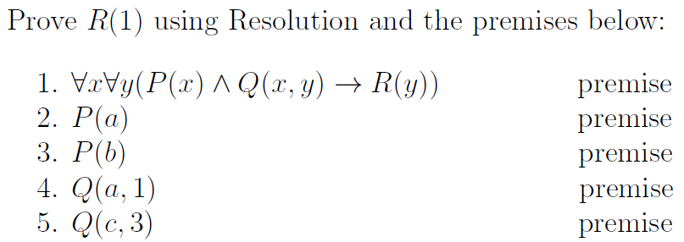
Proof Example

Slide 19
Proof Example
This is the special expression form that you’ll need to know how to convert to CNF

Slide 20
Proof Example
Conversion Steps
Use conditional disjunction equivalence
Move negation inwards via Demorgan’s laws
Use distribution to turn into disjunction
This is the special expression form that you’ll need to know how to convert to CNF

Slide 21
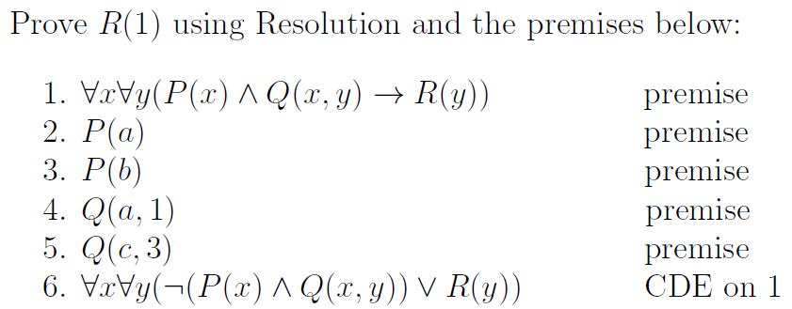
Proof Example
Conversion Steps
Use conditional disjunction equivalence
Move negation inwards via Demorgan’s laws
Use distribution to turn into disjunction
Step 1a

Slide 22
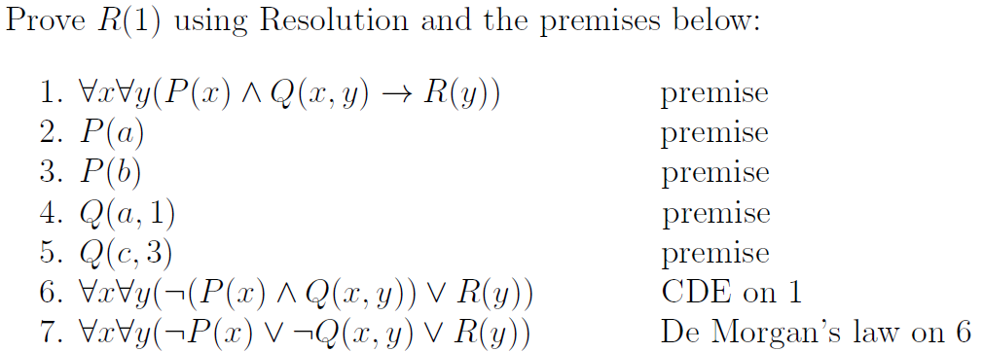
Proof Example
Conversion Steps
Use conditional disjunction equivalence
Move negation inwards via Demorgan’s laws
Use distribution to turn into disjunction
Steps 1b – 1c

Slide 23
Proof Example
Conversion Steps
Use conditional disjunction equivalence
Move negation inwards via Demorgan’s laws
Use distribution to turn into disjunction
Conjunctive Normal Form

Slide 24
Predicate Logic: Proof by Resolution
Proof by Resolution in Predicate Logic:
Convert all predicates into CNF-like predicates
Convert the implications and bi-implications to disjunction
Apply conditional-disjunction equivalence
Move negations inward with De Morgan’s laws
Use Distributive laws to group disjunction
Use Universal Instantiation to create a proposition
Use Resolution to prove new premises
Repeat steps 2 and 3 until proof is finished
Proof Steps
Convert to CNF-like
Use universal instantiation
Use resolution
Repeat

Slide 25
Proof Example
Proof Steps
Convert to CNF-like
Use universal instantiation
Use resolution
Repeat

Slide 26
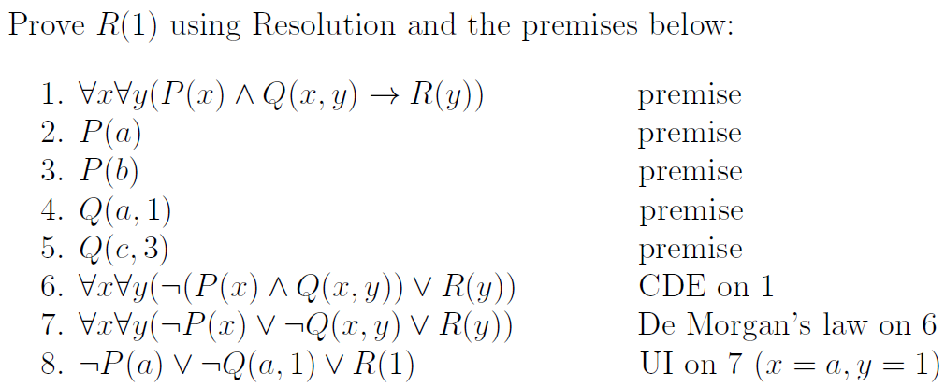
Proof Example
Proof Steps
Convert to CNF-like
Use universal instantiation
Use resolution
Repeat
Step 2

Slide 27
Proof Example
Proof Steps
Convert to CNF-like
Use universal instantiation
Use resolution
Repeat
Step 2
If it’s true for all x, it has to be true for every specific element of the domain

Slide 28
Proof Example
Proof Steps
Convert to CNF-like
Use universal instantiation
Use resolution
Repeat
Step 2
We get to choose which element
Why choose 𝑎 and 1?
𝑎 represents one specific element

Slide 29
Proof Example
Proof Steps
Convert to CNF-like
Use universal instantiation
Use resolution
Repeat
Step 2
We get to choose which element
Why choose 𝑎 and 1?
Match something we know in the KB

Slide 30
Proof Example
Proof Steps
Convert to CNF-like
Use universal instantiation
Use resolution
Repeat
Step 2
Notes:
Actually two steps x→ a and y→1

Slide 31
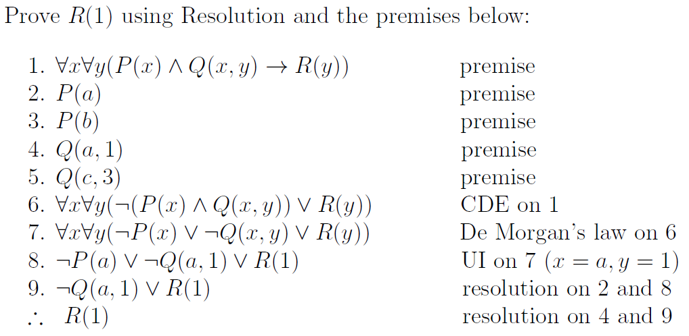
Proof Example
Proof Steps
Convert to CNF-like
Use universal instantiation
Use resolution
Repeat
Step 3

Slide 32
Proof Example
Proof Steps
Convert to CNF-like
Use universal instantiation
Use resolution
Repeat
Step 3
Once we apply UI, we can just use resolution from propositional logic

Slide 33
Proof Example
Proof Steps
Convert to CNF-like
Use universal instantiation
Use resolution
Repeat
Step 3
Now what

Slide 34
Proof Example
Proof Steps
Convert to CNF-like
Use universal instantiation
Use resolution
Repeat
Step 3

Slide 35
Proof Example
Proof Steps
Convert to CNF-like
Use universal instantiation
Use resolution
Repeat
Step 2
We get to choose which element
What if we had chosen c and 3?
𝑎 represents one specific element

Slide 36
Proof Example
Proof Steps
Convert to CNF-like
Use universal instantiation
Use resolution
Repeat (choose something else in domain)
Step 2
We get to choose which element
What if we had chosen c and 3?
𝑎 represents one specific element

Slide 37
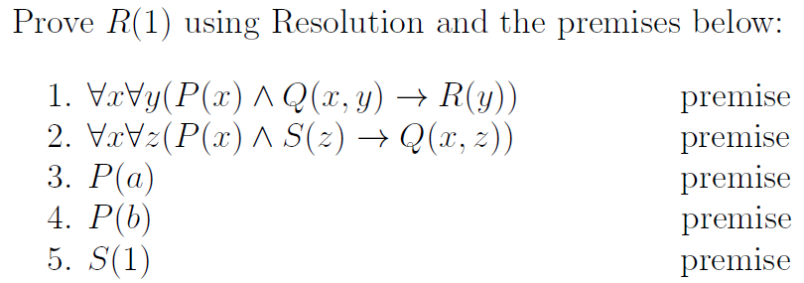
Proof Exercise

Slide 38
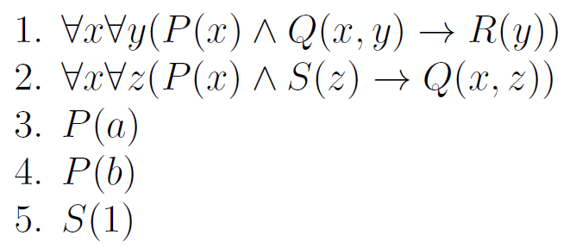

Connection to Datalog
Recall the proof premises
and the conclusion to prove
This is the corresponding Datalog program

Slide 39
Connection to Datalog
Recall the proof premises
and the conclusion to prove
This is the corresponding Datalog program
We can answer datalog queries using
proofs in predicate logic, and resolution
is the only rule of inference we need

Slide 40
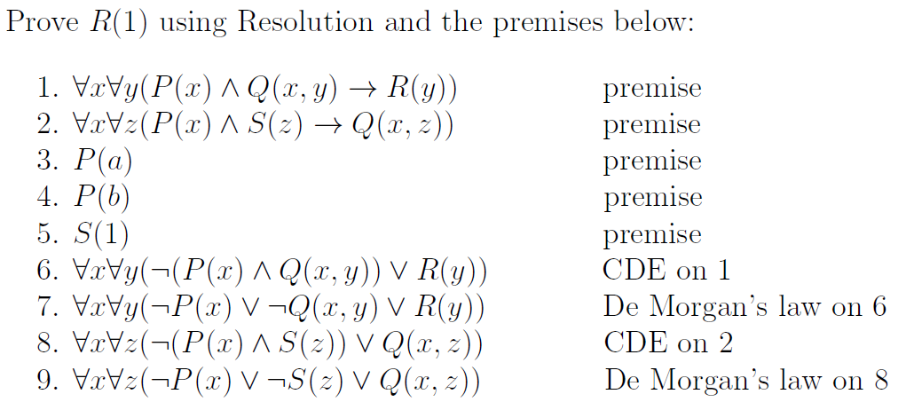
Proof Exercise
Proof Steps
Convert to CNF-like
Use universal instantiation
Use resolution
Repeat (choose something else in domain)
Step 1

Slide 41
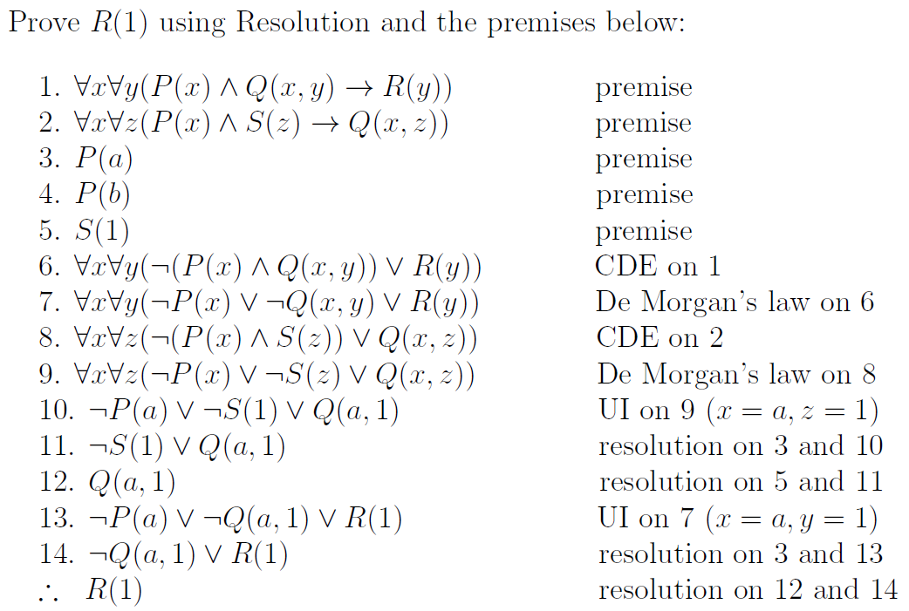
Proof Steps
Convert to CNF-like
Use universal instantiation
Use resolution
Repeat (choose something else in domain)
Step 1
Step 2
Step 3
Step 2
Step 4
Step 3

Slide 42
Proof Steps
Convert to CNF-like
Use universal instantiation
Use resolution
Repeat (choose something else in domain)
Step 2
Step 3
Step 2
Step 4
Step 3

Slide 43
Proof Steps
Convert to CNF-like
Use universal instantiation
Use resolution
Repeat (choose something else in domain)
Step 3
Step 2
Step 4
Step 3

Slide 44
Proof Steps
Convert to CNF-like
Use universal instantiation
Use resolution
Repeat (choose something else in domain)
Step 3
Step 2
Step 4
Step 3

Slide 45
Proof Steps
Convert to CNF-like
Use universal instantiation
Use resolution
Repeat (choose something else in domain)
Step 3
Step 2
Step 4
Step 3

Slide 46
Proof Steps
Convert to CNF-like
Use universal instantiation
Use resolution
Repeat (choose something else in domain)
Step 3
Step 2
Step 4
Step 3

Slide 47
Proof Steps
Convert to CNF-like
Use universal instantiation
Use resolution
Repeat (choose something else in domain)
Step 2
Step 4
Step 3

Slide 48
Proof Steps
Convert to CNF-like
Use universal instantiation
Use resolution
Repeat (choose something else in domain)
Step 2
Step 3

